Slide 1

Introduction to Enterprise Chat and Search
Dr. Nirandika Wanigasekara
Dr.Sherry Yu
Kanjinghat Nijesh AI Engineer, Client Engineering
watsonx.ai
Notes:
Curated by Catherine.Cao@ibm.com

Slide 2
대화형 AI란?
대화형 AI
라지 랭귀지 모델
기업 지식베이스
일반
지식베이스
결제를 상환받고 싶습니다.
금액은 얼마입니까?
발화를 이해하지 못함
NLP
NLU
응답
요청을 정리
발화를 이해함.
인간과 유사한 답변을 작성하거나 문제 해결 자동화
액션 예측
맥락과의 관련성
올바른 주제 식별
개인화된 액션을 트리거하기 위해 정보 추출
Notes:
Automating a client’s customer service agents is the largest Conversational AI use case. Conversational artificial intelligence (AI) refers to technologies, like virtual assistants or virtual agents, which users can interact with in a natural way. They use large volumes of data, machine learning, natural language processing (NLP), and natural language understanding (NLU) to help imitate human interactions, recognizing speech and text inputs, and translating their meanings across various languages.
Let’s examine the algorithms behind conversational AI:
Natural language processing (NLP) NLP algorithms clean up incoming requests by correcting spelling, identifying synonyms, and interpreting grammar (like entities and verbs, actions, and so on). They essentially break down a customer request into a vector representation of words and sentences that are more easily understood (and matched) by a machine.
Natural language understanding (NLU) NLU is a subfield of NLP and is composed of a variety of deep learning and machine learning models. It is responsible for identifying the correct intent of a customer’s request and extracting important information. This important information, along with proprietary algorithms like Semantic Understanding, can be used to trigger additional actions and helps the point of interaction (kiosk, voice prompt, chatbot, and other channels).
Response generation During this stage, a correct response is formulated. This is an area where conversational AI outshines basic rule-based solutions, such as “vanilla” chatbots. With the information gathered by the NLU – such as customer intent, context, entity extraction of requests and subjects (nouns) and of desired actions (verbs) – combined with a structured hierarchy of conversational flows, conversational AI can generate the right response, whether it's answering a simple question, or carrying out a complex transaction on behalf of a customer.
Large language models (LLMs) If the assistant does not recognize the customer request – usually because it hasn’t been trained on it – it can send the request to an LLM. A custom LLM can be trained on a client’s corpora and can use this knowledge to address the user’s question. If the answer can not be found in their corpora, the LLM can also use its general knowledge to answer the question. LLMs add a significant level of flexibility to an assistant’s ability to answer user questions.
An additional 6-minute “What is Conversational AI” video is available here: https://youtu.be/pOUBt-S5dHY.
Citations:
https://www.ibm.com/cloud/learn/machine-learning
https://www.ibm.com/cloud/learn/natural-language-processing
https://www.ibm.com/cloud/watson-natural-language-understanding
https://youtu.be/pOUBt-S5dHY

Slide 3
대화형 서치
대화형 서치은 RAG 패턴을 구현하고, Watson Discovery 또는 Elasticsearch와 같은 벡터 데이터베이스 또는 검색 툴에 저장된 회사별 콘텐츠에서 답변을 생성하는 맞춤형 LLM에 watsonx Assistant를 커넥트하여 질문 답변을 자동화합니다.
현시점에서 가능 :
사용자 커스텀 개발 없이 커스텀 익세텐션을 통해 RAG를 설정하기 위한 OpenAPI 사양이 포함된 스타터 키트
Watsonx내에 FLAN-UL2-20b 모델
가까운 시일 내 가능 :
watsonx 및 Watson Discovery에서 FLAN-UL2-20b 모델을 사용한 네이티브 인티그레이션
향후 :
watsonx CoGA를 사용한 네이티브 인티그레이션: 리랭커 모델 및 응답 추적 기능을 갖춘 IBM 빌드 모델
벡터 데이터베이스 역시 네이티브 인티그레이션 : Elasticsearch
개인화된 대화형 검색
액션 + LLM의 보조 + LLM 주도
제어 감소
액션 + LLM 의 보조
액션 주도의 대화형 설계
전통적인 인텐트/다이얼로그
유연성 (보다 강력한 고객 경험)
Notes:
Conversational search is a feature in watsonx Assistant that allows a virtual assistant to search a knowledge base for information relevant to a question and use the relevant information to generate a conversational answer to the question. This feature is an adaptation of retrieval augmented generation (RAG), a standard technical approach to improving a Large Language Model’s (LLM) ability to answer questions accurately.
When it comes to enterprise use cases, where specialized and customer-specific information is involved, general purpose language models fall short. Fine-tuning these models with new corpora can be expensive and time-consuming. The RAG technique to address this challenge.
With RAG, Assistant connects to customized watsonx LLMs that generate answers to questions. The way watsonx Assistant assures that those answers are accurate is by grounding them in company specific content, which is typically stored in a knowledge base or content management system. That's then searched by a search tool like Watson Discovery or stored in a vector database.
The graphic on the right-hand side of the slide maps RAG features along with how much control a Conversational AI solution keeps in the hands of a subject matter expert that builds intents in the assistant, vs. putting more control in the hands of the LLM. When the solution uses an LLM, whether on LLM-assisted features like conversational search, retrieval and augmented generation, or on LLM-controlled experiences, the assistant is more robust in answering customer queries for which it has not been trained on.
The watsonx Assistant team is working with IBM Research and the watsonx team to develop a custom, fine-tuned, and prompt-engineered large language model called Content-Grounded Assistant (CoGA) that specializes in generating answers from search results. CoGA is available in watsonx tech preview today. It will be available in watsonx later in Q3 2023.
In the meantime, while the watsonx Assistant team works to make CoGA available on watsonx, the watsonx Assistant team recommends using prompt-engineered FLAN-UL2-20b, an open-source model, to generate answers from search results. FLAN-UL2-20b is available in watsonx today.
Non-watsonx LLMs can also be fine-tuned or prompt-engineered to perform conversational search. These LLMs can be integrated with watsonx Assistant via extensions. This pattern may be preferable to clients who train their own LLMs in-house.
The rest of the slide is self-explanatory and shows the near- and medium-term road map to integrating with LLMs.

Slide 4

대화형 서치 작동 흐름과 watsonx Assistant가 주는 부가 가치
“잔액 이체에 대해 마일리지를 적립할 수 있나요??”
watsonx Assistant
Watson Discovery
watsonx Assistant
Natural language understanding
Corporate knowledge base
질의
질문 + 답변 결합
질의
질의
watsonx
라지 랭귀지 모델
watsonx Assistant
사용자에게 응답 표시
응답 생성
재순위화
Demo → | Hands-on lab →
Notes:
This slide walks through the order of operations in conversational search:
1. First, the end user asks the virtual assistant a question.
The virtual assistant uses its natural language understanding (NLU) model to determine whether it recognizes the question and whether it can answer it using one of its actions for which it has been trained. For example, a bank’s assistant is usually trained on answering a question such as, help me locate the nearest branch. If the virtual assistant recognizes the question, it answers it using the appropriate action. Conversational search is not needed, and watsonx Assistant does not need to call watsonx. However, If the assistant does not recognize the question, it will go to conversational search.
2. With conversational search, the virtual assistant sends the end user’s question, also known as a query or request, to a search tool, such as (but not limited to) Watson Discovery. Watson Discovery has read and processed all relevant corporate documents.
3. The search tool (Watson Discovery) will then search its content and produce search results in response to the question.
4. The search tool passes these search results back to the virtual assistant in a list.
5. At this point, watsonx Assistant could display the results back to the user. However, they would not resemble natural speech; they would look like a summarized answer based on a search. Helpful – certainly – but not natural.
6. Therefore, watsonx Assistant sends the question and the list of search results to watsonx, which invokes a large language model (LLM). In some implementations of conversational search, a LLM re-ranks the search results. It may reorder or disregard some of the search results according to how relevant and useful it thinks the search results are to the question. For example, a LLM might decrease the ranking of a search result if it is from a document that has not been updated recently, indicating the information may be out of date. This capability is often called a “neural re-ranker.”
7. The LLM generates an answer to the question using the information in the search results, and the LLM passes this answer back to watsonx Assistant.
8. The virtual assistant presents this conversational answer to the end user.
Answer traceability. In some implementations of conversational search, the virtual assistant may show the end user the search results that the LLM used to generate the answer. This allows the end user to trace the answer back to its source and confirm for themselves its accuracy. This capability is often called “answer traceability.”
Custom passage curation. In other implementations of conversational search, the virtual assistant also shows the end user snippets of the search results that the LLM used to generate the answer. These snippets might be direct quotes or 1-2 sentence summaries of the relevant information in each search result. This allows the end user to understand exactly what the LLM pulled out from the search result to craft its answer. This capability is often called “custom passage curation.”
Conversational search is much more than document summarization or simple search. It includes the entire process of recognition, search, and answer generation; sometimes also including a neural re-ranker, answer traceability, and custom passage curation.
The value-add of watsonx Assistant in conversational search is its ability to orchestrate and connect every component of conversational search using its NLU model, no-code actions, OOTB connectors, and custom extensions.
For a demonstration of this order of operations, sellers can view the demo video; to get hands-on, they can also step thru the lab:
Demo video: https://ibm.seismic.com/Link/Content/DCXWV8bRFjPTD8MQ767DGC2GV6Tj
Hands-on lab guide: https://ibm.seismic.com/Link/Content/DCWpd8WCHQm2MGmFWQJBHmTHcg2d

Slide 5

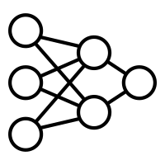







대화형 서치 watsonx Assistant + 커스텀 watsonx LLM 아키넥쳐
watsonx Assistant는 커스텀 watsonx LLM 및 Watson Discovery에 저장된 회사별 컨텐츠에 네이티브하게 연결됩니다
엔드 유저
watsonx Assistant
Core LLM-Based Classifier
검색 결과를 요약하는 LLM 사용
해결 방법
External
LLM Agent
External
LLM Agent
코어 LLM 기반 서치
LLM 기반외부 서치
정해진 액션
정해진 액션
정해진 액션
정해진 액션
정해진 액션
익세텐션 (watsonx Assistant에는 외부 서비스 및 watsonx LLM을 위한 사전 구축된 여러 확장 스타터 키트가 포함되어 있음)
Watson Discovery
Bring your own Search
Bring Your Own Extension
파트너 솔루션
Notes:
From an architectural view, watsonx Assistant connects to customized LLMs in watsonx and company specific content all via custom extensions. Currently, Assistant connects via custom extension to watsonx, and a search tool like Watson Discovery, Elastic, or so on. In the near future, these integrations will no longer be a custom extension but will be available natively within Assistant.
With no code and no manual effort, users can set up conversational search natively in watsonx Assistant.
The value-add of watsonx in conversational search is its customized large language model, especially Content-Grounded Assistant (CoGA), designed and customized by the watsonx Assistant, IBM Research, and watsonx teams to perform well for conversational search.

Slide 6
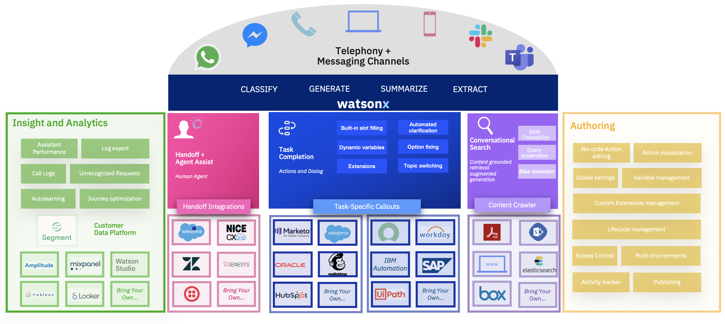
watsonx Assistant의 확장성 있는 아케텍처는 생성형 AI 및 자동화를 포함하고 있어 기업이 AI 어시스턴트를 대규모로 구축, 실행 및 관리할 수 있습니다.
Notes:
IBM watsonx Assistant provides an omni-channel experience regardless of how the user chooses to communicate, and delivers a consistent, personalized, and convenient end-user experience without clients needing to migrate their technology stack. The days of waiting on hold, dialing menu options, confusing agent transfers with customers repeating credential challenges and re-detailing issues are now over. IBM watsonx Assistant seamlessly integrates with existing telephony and interactive voice response (IVR) systems, eliminating call wait times, and enabling 90% first-call resolution rates.
Omnichannel – also spelled omni-channel – is a multichannel approach to customer service that seeks to provide customers with a seamless experience, whether they’re online on a desktop or mobile device, or on the phone. IBM watsonx Assistant operates in text-based forms, can be integrated into an SMS-based setting, and other messaging solutions (like Facebook Messenger, WhatsApp, and so on). It also operates through a voice interface, which can be integrated with phone systems. Whether it's chat, phone, WhatsApp, or some other channel, the user will have the same consistent interaction with watsonx Assistant.
[Blue section] All of the Telephony and Messaging Channels tie to a Conversation Infrastructure that can access any backend data source using custom extensions. Extensions – which are discussed in more detail later in this presentation – provide a Task-based Integration to a company's applications to deliver a unique and personalized experience to the customer. Extensions can tie to other connector tools – like IBM AppConnect – which maintains pre-built connectors to a variety of data sources.
[Purple section] In addition, extending watsonx Assistant conversational AI with AI-powered search with Watson Discovery or other search tools can help customers resolve their problems in an automated way, even for the most complex questions. IBM watsonx Assistant, is especially supercharged with Watson Discovery, a powerful AI search and knowledge tool that allows it to quickly locate information across enterprise content repositories for the most accurate, up-to-date information, on the fly. Whether it’s in spreadsheets, knowledge bases, or unstructured documents like PDFs, Watson Discovery can find and pull up the information that clients need fast. For customers that have a preferred Search provider, IBM watsonx Assistant maintains starter kits to common search tools. This ability to extend the knowledge of the virtual assistant without necessarily having to train it means that fewer customer inquiries will need manual intervention.
If an interaction needs integrations at every turn of a conversation, clients can use Pre-message and Post-message webhooks to make calls to services such as Watson Language Translator or Watson Natural Language Understanding (NLU) to translate a customer’s requests or provide deeper insight into the tone, emotion, or sentiment of a customer.
[Pink section] In the event that IBM watsonx Assistant, cannot complete a user's request, IBM provides full contact center hand-off to human agent integration capabilities with partners such as Genesys, NICE CXone, and others, whether the hand-off is chat- or voice-based.
[Yellow section] To make all of this possible, IBM watsonx Assistant, delivers a no-code authoring experience, infrastructure, and insights. The no-code authoring experience is purposefully designed to allow a business to build, launch, and scale an assistant with business users and expertise – not developers or machine learning experts. This flexibility and scalability also means that clients can scale up their contact center capacity without having to hire more agents.
[Green section] Finally, insights are provided in IBM watsonx Assistant via a dedicated Analytics dashboard, various log APIs, and a partnership with customer data platform Twilio Segment. Segment maintains a variety of prebuilt connectors to popular analytics tools and data warehouses, so clients can easily organize and export data from watsonx Assistant and all customer journey touchpoints, into the tool or warehouse of their choice. As a side note, log streaming and Segment integration require an Enterprise plan. (Pricing plans are discussed later in this presentation.)
Citation:
https://www.ibm.com/blogs/watson/2020/08/gm-financial-uses-ibm-watson-assistant-to-develop-a-secure-and-powerful-ai-assistant/
6

Slide 7
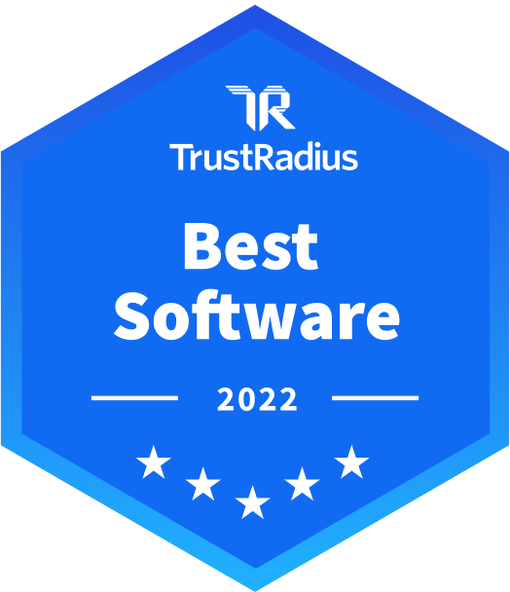
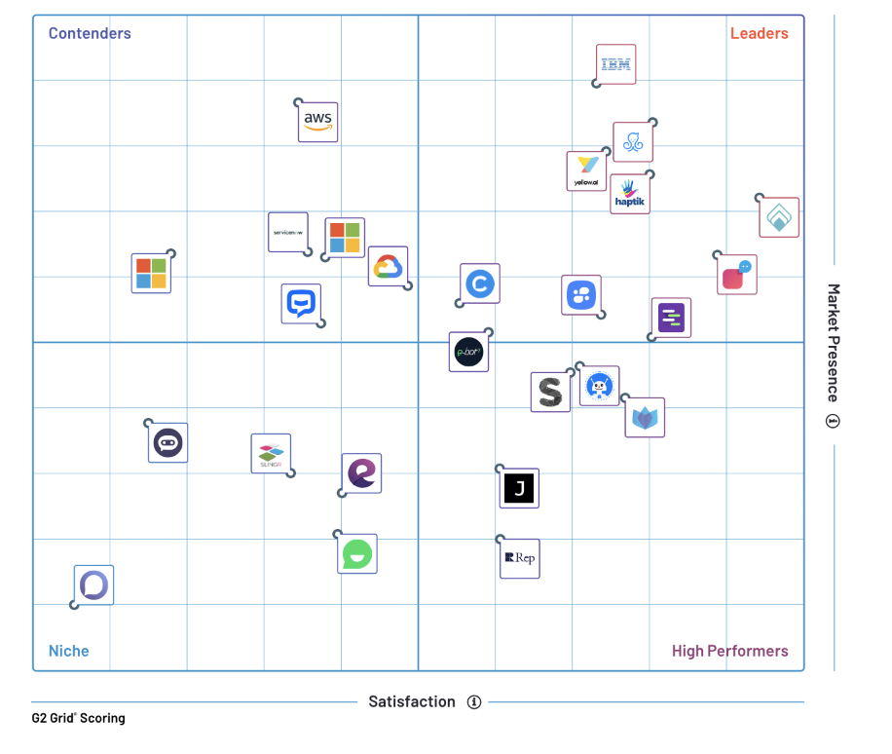

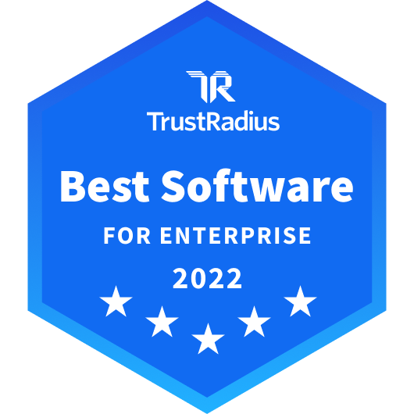
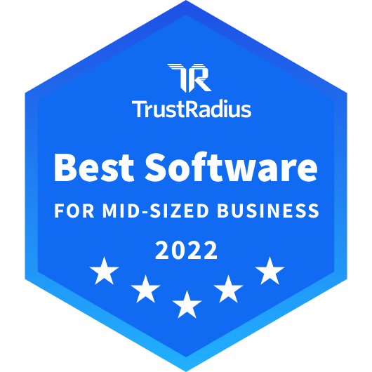

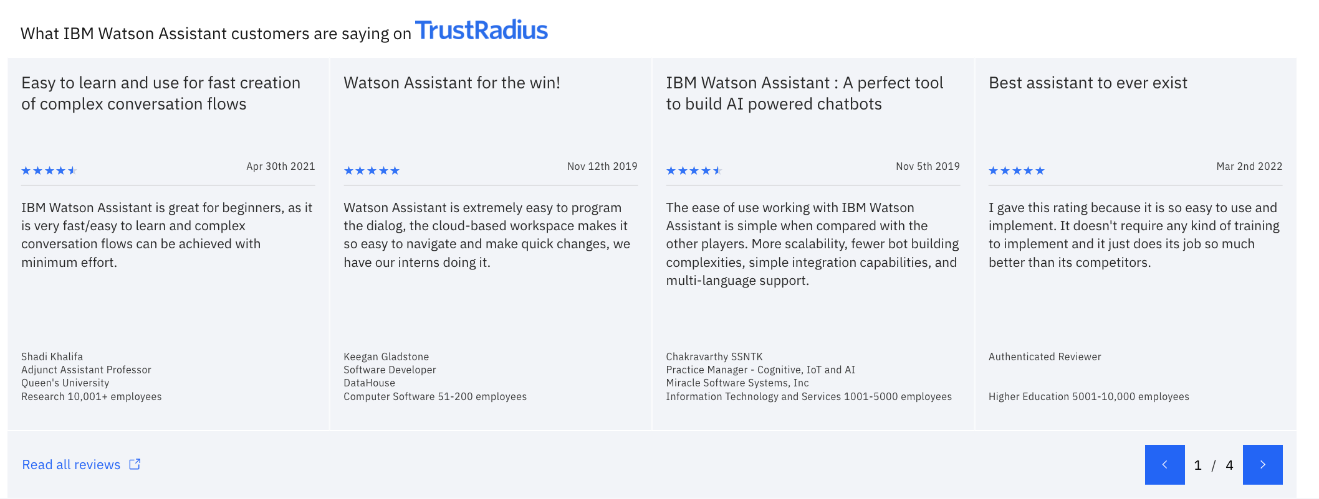
IBM watsonx Assistant는 고객의 지속적인 신뢰를 받고 있습니다.
2018
—
Forrester Waves
대화형 컴퓨팅의 리더
IBM watsonx Assistant는 G2 Spring 2022 Bot Platforms Software 보고서에서 리더로 선정되었습니다.
IBM watsonx Assistant는 세 가지 시장 범주인 엔터프라이즈, 미드마켓 및 중소기업에서 모두 2022년 TrustRadius Best Software 상을 수상했습니다.
2019
—
Forrester Waves
코그니티브 서치의 리더
2020
—
Forrester Waves
AI 기반 텍스트 분석의 리더
2021
—
Gartner Magic Quadrant 인사이트 엔진의 리더
Bot Platforms의 제품 중 가장 큰 시장 입지를 가졌습니다.
94%의 사용자가 별 4개 또는 5개를 평가했습니다.
92%의 사용자가 올바른 방향성을 가지고 있다고 생각한다고 했습니다.
87%의 사용자가 IBM watsonx Assistant를 추천할 의향이 높다고 했습니다.
2022
—
Gartner MQ 엔터프라이즈 대화형 AI 플랫폼의 리더
Notes:
IBM watsonx Assistant is rated highly by clients, as also shown in other recent reports, with high percentage of respondents stating they are likely to recommend it, or that they would buy it again, if given the opportunity.
The rest of this slide is self explanatory, and more detail can be found in the links in the speaker notes.
Citations:
https://www.g2.com/categories/bot-platforms
https://www.trustradius.com/products/ibm-watson-assistant/reviews
https://www.ibm.com/cloud/blog/announcements/11-ibm-products-lead-the-way-in-the-trustradius-best-of-summer-awards

Slide 8
Watson Discovery는 완전하고 독보적인 문서 및 언어 이해(Understanding) 플랫폼입니다
비즈니스 문서의 어느 곳에서나 정확한 답변 찾기
AI는 시각적 문서 구조에 대한 이해와 자연어에 대한 이해를 결합하여 표, 사실, FAQ, 대화 상자 등 사용자가 원하는 어떠한 형식으로 관련성이 높은 답변을 제공합니다.
모든 비즈니스 영역에 빠르게 적응
Out-of-the-box로 시작하여, 간단한 제안 기반 학습으로 개선하고, 고급 ML 로 접근해보세요. 비즈니스 사용자를 위해 설계되어 더 적은 교육으로 가치를 실현하고 최종적인 결과물에 더 집중할 수 있습니다.
어디서나 확실하고 안전하게 배포 및 확장
Cloud Pak for Data를 사용하여 클라우드, 호스팅, 온프레미스, 하이브리드 등 모든 환경에 배포하세요. 기업 규모와 보안에 알맞게 만들어졌습니다.
Notes:
Watson Discovery pinpoints answers from anywhere in business documents. Its AI combines the understanding of visual document structure, with the understanding of natural language, to provide highly relevant answers in whatever form users need: tables, facts, FAQs, dialogs, and so on.
Watson Discovery rapidly adapts to any business domain. Clients can start out-of-the-box, improve with simple suggestion-based learning, and build up to advanced ML approaches. Watson Discovery is designed for business users, allowing them to realize value incrementally, with less training, and more focus on end results.
Built for enterprise scale and security, Watson Discovery can be deployed and scaled anywhere – confidently and securely. It can deploy on any environment: cloud, hosted, on-premises, hybrid – with Cloud Pak for Data.

Slide 9
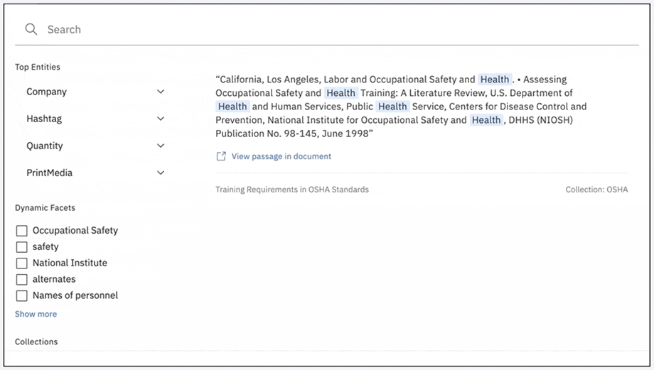
IBM의 비전
지식 근로자(knowledge worker) 가 정보 및 인사이트 검색을 자동화하고 가속화하여 지능적인 비즈니스 프로세스를 만들 수 있도록 합니다
고객에게 선사하는 결과
일반적인 지식 근로자는 근로 시간의 30%를 지식을 검색하는데 사용하는데, 이 시간의 75%를 감축합니다
Notes:
IBM’s vision is to augment a worker’s ability to understand the corpus of complex, high value documents needed for business decisions, and to do this by providing immediate access to concise, trusted, and personalized information, regardless of form (structured or unstructured). This vision is realized with the IBM Watson portfolio of enterprise AI applications, primarily through Watson Discovery.
IBM Watson Discovery is an AI powered search and document analysis platform that augments the ability of experts in an organization to find critical information quickly, and to understand high value business documents, thus reducing time spent searching for – and understanding – information.
Providing immediate access to concise, trusted, personalized information can reduce the 30% of time a typical knowledge worker spends searching for information by up to 75%! Furthermore, it enables knowledge workers to make better, faster business decisions. Factoring in these time savings by the 1 billion knowledge workers in the world, the potential impact on productivity and global economic growth is – well – mind-blowing. Another reminder that AI is the biggest economic opportunity of our lifetime.
Citation:
Forrester Total Economic Impact Study - https://www.ibm.com/account/reg/us-en/signup?formid=urx-49770&_ga=2.208646418.1014117414.1615406954-1597149180.1599870494

Slide 10
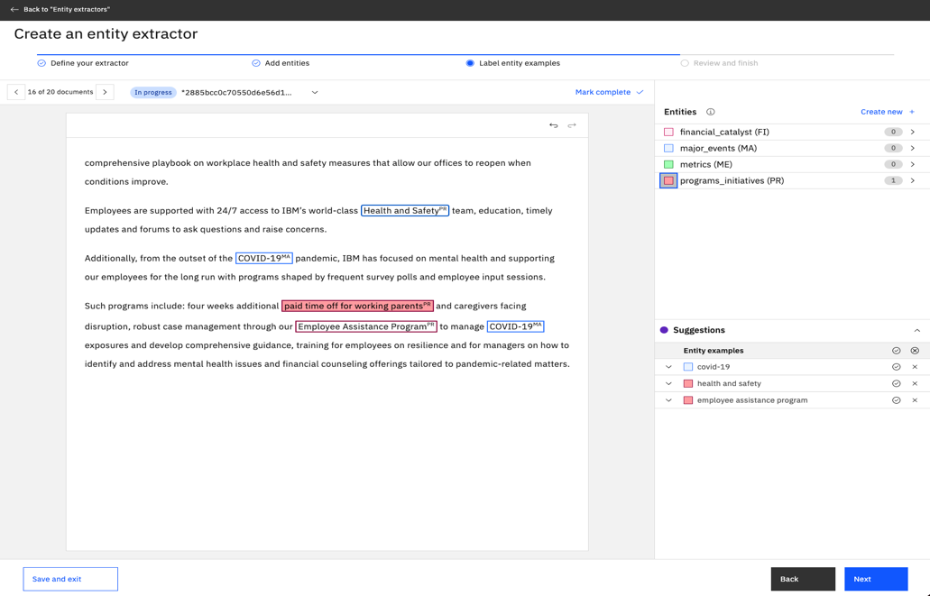

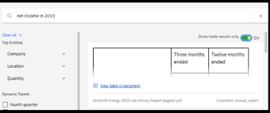
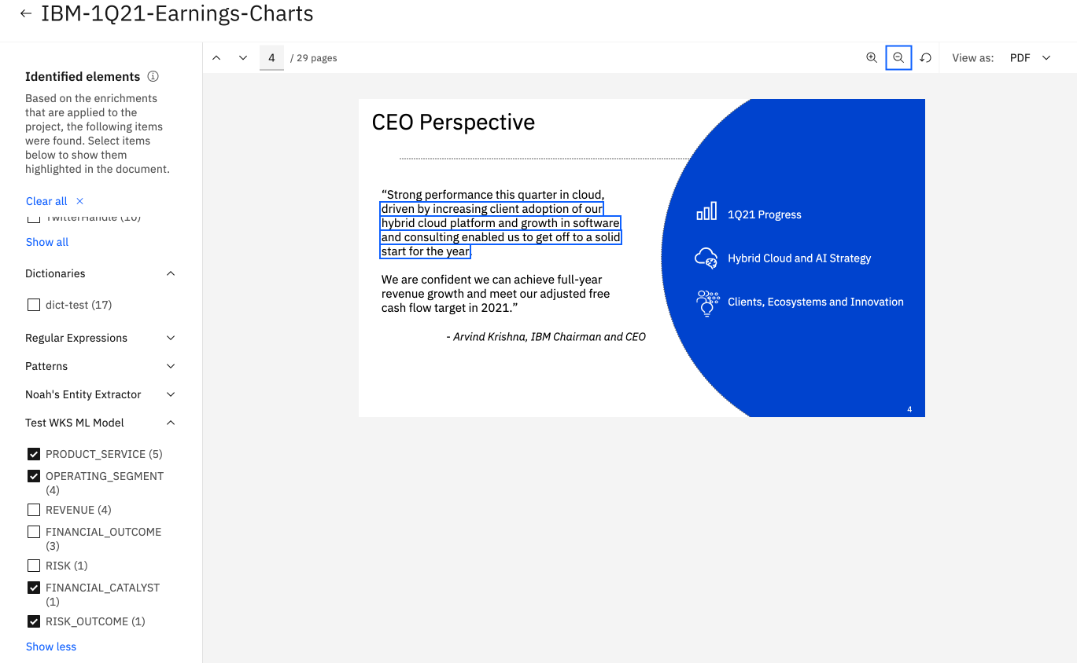
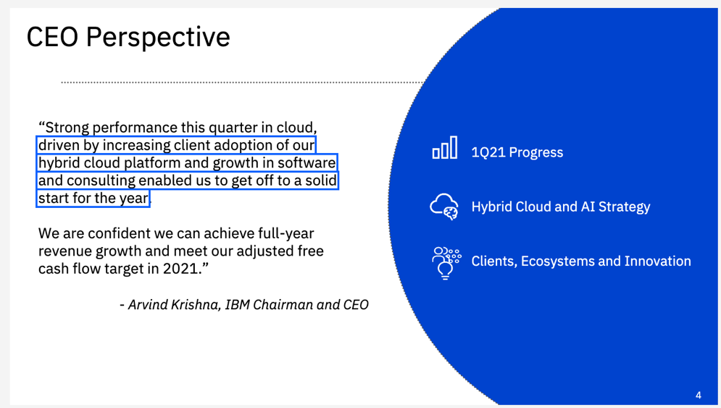
Analyze
어떤 형태로든 맥락에 맞는 답변과 인사이트를 얻으세요
AI를 사용하여 모든 애플리케이션, 사용자 프로세스를 위한 답변을 제공합니다.
사용자 지정 엔터티 추출
ML 모델을 학습시켜 사용자가 지정한 엔티티를 빠르고 일관된 방식으로 추출하여 도메인 커스텀 역량을 애플리케이션에 효과적으로 적용합니다.
Facet Navigation
작업에 대한 관련 정보가 있는 문서만 필터링합니다.
모델 예측을 시각화하고 툴링 UI에서 원본 문서의 맥락상에서 증거를 확인합니다. JSON 뷰에서 모델 예측, 신뢰도 및 기타 메타데이터를 검증합니다.
테이블 검색
테이블에 표시되는 답변을 찾고 맥락을 유지하기 위해 테이블 구조를 유지합니다.
Notes:
Facet Navigation gives users the navigation capability to filter down to only the select documents which contain the relevant information needed to accomplish their task. Users can visually see the model predictions and check the evidence in the context of the original documents from the tooling UI. Further, users validate the model predictions, confidence, and other metadata captured with the Natural Language Processing from the JSON view.
Watson Discovery also understands tables, meaning it enables knowledge workers to find answers that were previously hidden or difficult to find, because the answers were either in a table or need to be displayed back as a table. This decreases the manual effort previously required to sift through pages and pages of documents, in order to locate the table where an answer may lie.
Custom Entity Extraction allows users to define custom entity types and annotate entity mentions to iteratively train a supervised entity recognition model. The training is visual and done by a subject matter expert, requiring no coding, and deploys with a single click. For example, in analyzing documents related to car accidents, Watson Discovery can quickly be trained to identify entities such as make and model, mileage, symptoms, problems, and so on.

Slide 11
엔터프라이즈 채팅 및 검색을 위한 watsonx
엔터프라이즈 옴니 채널 어시스턴트 구축
엔터프라이즈 서치 구축
윤리적 AI가 제품의 핵심에
라지 랭귀지 모델에 액세스
기존 툴의 용도 변경
기업을 위한 개발
Notes:
This section contains the main capabilities that make IBM watsonx Assistant the industry’s leading virtual assistant service. Each of the product features is tied to the differentiators shown on this slide.
11

Slide 12
Notes:
This slide is self–explanatory and requires no speaker notes.

Slide 13
watsonx Assistant의 역량
Tell, do, and show
신속한 구축 및 이터레이션
접근 가능하고 확장 가능한 AI
일관되고 개인화된 경험
진정한 고객 성과
기업을 위한 설계
Notes:
This section contains the main capabilities that make IBM watsonx Assistant the industry’s leading virtual assistant service. Each of the product features is tied to the differentiators shown on this slide.
13

Slide 14
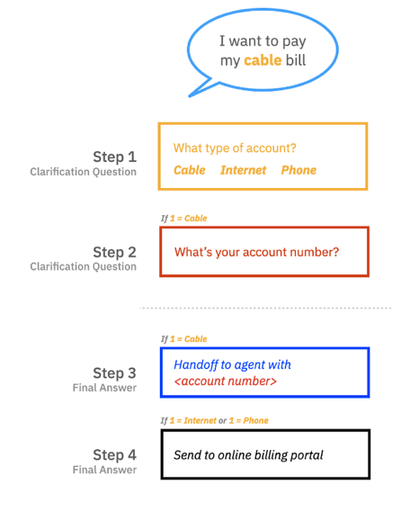
신속한 구축 및 이터레이션 액션
누구나 놀랍도록 쉽고 빠르게 가상 어시스턴트를 구축, 게시 및 개선할 수 있습니다.
여러 action과 단계를 거쳐 이질적인 개념들이 통합되고 커스텀 컨텐츠의 구성 요소가 됩니다
OpenAPI 사양을 사용하여 그 어떤 백엔드 시스템과의 통합을 쉽게 정의할 수 있습니다.
Learn → | Blog → | Demo →
Notes:
While chatbots are a great way to naturally and efficiently help customers get things done, most chatbot building tools today are either overly simplistic and break whenever someone asks something unexpected, or they are designed to be built and maintained by developers, making it very hard for content-focused individuals to collaborate.
IBM watsonx Assistant has a build experience tailored to a company’s staff who directly interact with customers daily, without sacrificing any of its powerful conversational AI features.
Assistant automatically handles all sorts of things that could happen during a conversation, such as topic changes, vague requests, misunderstandings, and asking for a human agent. Actions, and the steps within an action, consolidate many disparate concepts and become the building blocks of custom content: no more separate intents, entities, and nodes.
Furthermore, multiple team members can work on a given assistant. In addition, Actions can also be exported and imported between different assistants.
Finally, there is a “try it out” preview experience built into the action edit flow, before a change is committed.
This slide, as well as most other product features slides that follow, have links both on the slide, and in the speaker notes, that allow sellers to learn more about the feature, and either watch the feature demonstrated, or experience it themselves. For example, on this slide, sellers can learn more about Actions by clicking on the Learn, Blog, and Demo links on the slide, or the same citation links in the speaker notes.
Citations:
https://ibm.seismic.com/Link/Content/DCmHWCM4pjc6P8hJ46DbQTFc6cfP
https://www.ibm.com/blogs/watson/2021/12/getting-started-with-the-new-watson-assistant-part-i-the-build-guide/
https://ibm.box.com/v/wa-actions-deepdive (IBMers only)

Slide 15
신속한 구축 및 이터레이션 서브 액션
항공편 예약 Action
포인트 사용 Action
Step 1
Step 1
재사용 가능한 플로우로 어시스턴트의 크기와 복잡성 감소시킵니다
플로우를 한 번 구축하고 어시스턴트의 다른 작업에서 호출합니다.
Step 2
Step 2
Step 3
마일리지 서비스 정보 검색 Action
Step 1
Step 2
Step 3
End action
Step 4
Step 3
End action
End action
Notes:
Sub-actions reduce the size and complexity of a virtual assistant with reusable flows. They allow clients to build a flow once and call it from any other action in the assistant – like the example in the graphic of this chart.
In the example on the right-hand side of the slide, notice how both the Book a flight Action and Redeem points Action use a common Retrieve frequent flier info Action; think of this as microservices for IBM watsonx Assistant flows.

Slide 16





신속한 구축 및 이터레이션 사전 구축된 채널 통합
Sa
사전 구축된 채널
그 어떤 것과 통합됩니다.
IBM watsonx Assistant는 다양한 사전 구축된 채널을 지원하여 어시스턴트와의 통합을 가속화할 수 있습니다.
Phone
Webchat
Slack
SMS
Facebook
Messenger
WhatsApp
Learn → | Blog →
Notes:
In addition to its web chat channel, IBM watsonx Assistant can be integrated with a wide array of platforms that IBM client’s customers are already on.
As shown on this slide, IBM watsonx Assistant now supports a long list of pre-built channels to help accelerate deployment so that companies can meet their customers where they are.
Citations:
https://medium.com/ibm-watson/watson-assistant-integrations-channel-your-knowledge-909dfecae26
https://ibm.box.com/v/wa-channels-deepdive (IBMers only)

Slide 17
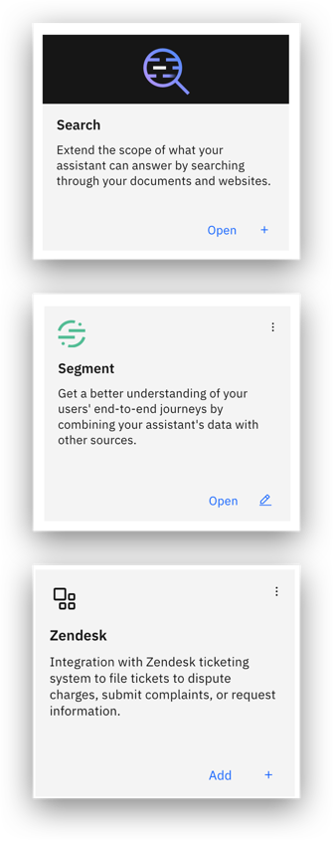
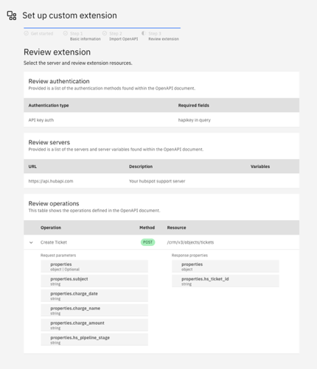
신속한 구축 및 이터레이션 익스텐션
Sa
가장 일반적인 유스케이스(티켓 제출, 내부 데이터베이스 작업, 공용 API 등)를 위해 IBM watsonx Assistant를 빠르고 쉽게 통합합니다.
OpenAPI 사양을 사용하여 백엔드 시스템과의 통합을 쉽게 정의할 수 있습니다.
Learn → | Blog 1 → | Blog 2 →
Notes:
With the Custom Extension capability, IBM watsonx Assistant can be integrated quickly and easily for the most common use cases: submitting support tickets, working with internal databases, public APIs, and more. This capability uses the OpenAPI specification to define integrations with a backend system. With this method, the integration is easy to set up, while still delivering powerful functionality.
Citations:
https://medium.com/ibm-watson/extending-watson-assistant-part-1-connecting-to-crm-systems-80deda33a68e
https://medium.com/ibm-watson/connect-to-backend-systems-and-third-party-apis-with-ease-thanks-to-watson-assistant-extensions-6d6150eaeba
https://ibm.box.com/v/wa-integrations-deepdive (IBMers only)

Slide 18
신속한 구축 및 이터레이션 Pre-message 혹은 post-message 웹훅
Sa
가상 어시스턴트에서 외부 데이터(예: 계정 정보)를 안팎으로 푸시하고 끌어옵니다
어시스턴트에게 전송되는 메시지를 전처리 또는 후처리하는 데 유용합니다. (예시 : 발신 메시지를 고객의 언어로 번역)
웹훅은 미들웨어 없이 웹훅이 연결되는 애플리케이션을 제어할 때 가장 편리합니다.
Blog →
Notes:
While IBM watsonx Assistant can drive the flow of a conversation, it often depends on external services for different kinds of information needed to convey to a customer, or for actions to be taken based on what a customer needs. For those cases where OpenAPI integration using Extensions is not sufficient, IBM watsonx Assistant uses Webhooks to integrate with external systems, without the need for middleware.
There are two main patterns in how Webhooks are implemented:
Personalizing conversations for users based on external information. For example, a virtual assistant can pull in user account information to add relevant details to the conversation, such as referring to specific services the customer is using.
Invoking actions in external systems. For example, opening a support ticket based on issues a customer raises in an interaction, or translating outgoing messages into the customer’s preferred language.
Suggested reading: https://medium.com/ibm-watson/connect-to-backend-systems-and-third-party-apis-with-ease-thanks-to-watson-assistant-extensions-6d6150eaeba

Slide 19
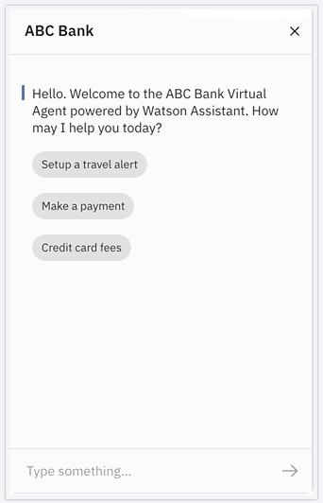
Tell, do, and show 웹챗
Sa
채팅 인터페이스를 구축하려면 돈과 시간이 듭니다
IBM watsonx Assistant 웹챗은 몇 분 안에 배포할 수 있습니다.
안전한 로그인
비주얼 커스터마이제이션
Learn → | Blog → | Demo →
Notes:
Building a chat interface takes months, and creating a meaningful experience takes longer. IBM watsonx Assistant, embedded with best practices, can be deployed in minutes. Plus, seamless agent escalation is built-in. For example, if a client uses ZenDesk (a popular help desk cloud-based software solution) for their live agent conversations with customers, they can configure IBM watsonx Assistant to hand the conversation session over to a live agent when certain conditions are met.
Other notable features include:
Secure Login: Once authenticated, IBM watsonx Assistant prevents improper use and impersonation.
Visual Customization: With no code required, users can easily edit the visual design to ensure seamless integration with their web site’s branding and color schemes.
Citations:
https://medium.com/ibm-watson/watson-assistant-web-chat-the-comprehensive-customer-care-solution-d72ed3deff35
http://lendyr.com/
https://ibm.box.com/v/wa-channels-deepdive (IBMers only)

Slide 20
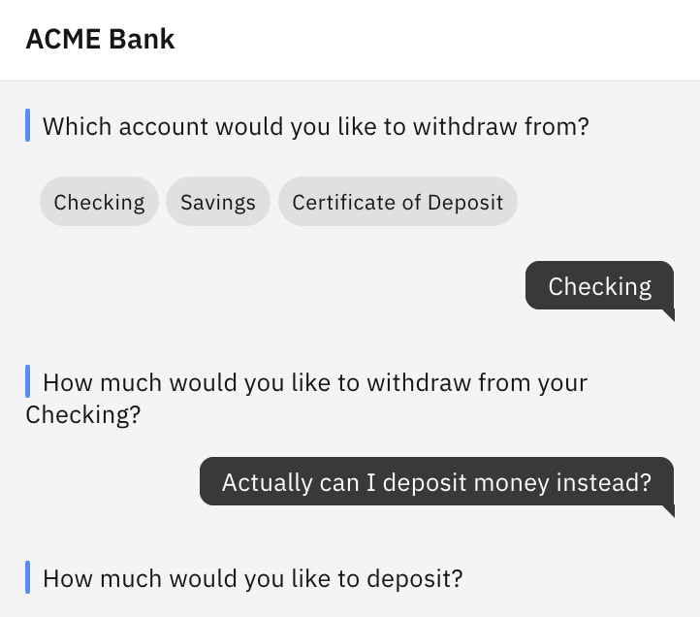
접근 가능하고 확장 가능한 AI 대화 주제 변경
Sa
원래 주제의 맥락을 유지하면서 대화 주제 변경
새 대화가 끝나면 원래 대화 주제로 돌아갑니다.
Learn → | Documentation → | Demo →
Notes:
IBM watsonx Assistant can navigate the complexities of human language. For example, in the middle of a conversation, customers might get distracted, ask questions about related issues, misunderstand something, or just change their minds about what they want to do.
The change conversation topic feature enables Watson-built virtual assistants to handle these digressions, dynamically responding to the user by changing the conversation topic as needed, and returning to the original topic once the digression conversation ends.
Citations:
https://cloud.ibm.com/docs/watson-assistant?topic=watson-assistant-change-topic
https://www.ibm.com/products/watson-assistant/demos/lendyr/demo.html
https://ibm.box.com/v/wa-nlu-deepdive (IBMers only)

Slide 21
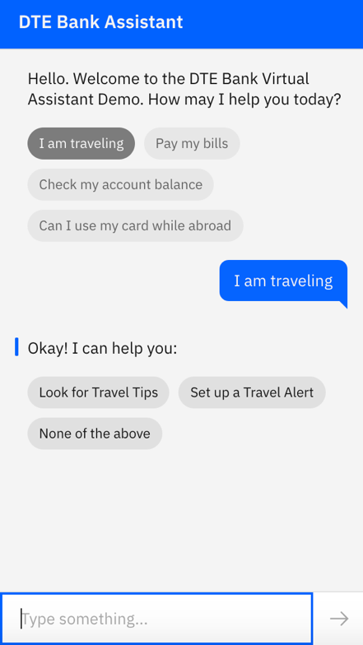
접근 가능하고 확장 가능한 AI Ask clarifying questions
Sa
IBM watsonx Assistant는 성급하게 결론을 내리지 않습니다.
명확한 질문을 통해 watsonx Assistant는 추측하지 않고 자동으로 설명을 요청합니다
Automatically disambiguates a user’s utterance if its unsure
Learn → | Blog → | Demo →
Notes:
When customers are conversing with a virtual agent – or even with another person – it’s common for things they express to be unclear. That’s why when people talk to one-another, it’s natural to ask for clarification. IBM watsonx Assistant includes models that detect ambiguous questions from the user; this is a technique called Disambiguation. Disambiguation prevents IBM watsonx Assistant from jumping to conclusions. Instead, it asks the customer questions to clarify their intent. This is a capability that can be turned on or off for specific portions of the overall conversation flow.
Citations:
https://medium.com/ibm-watson/prevent-stuck-conversations-with-disambiguation-suggestions-db4a40ee102f
https://www.ibm.com/products/watson-assistant/demos/lendyr/demo.html?section=accessible-scalable-ai&panel=accessible-ask-clarifying-questions
https://ibm.box.com/v/wa-nlu-deepdive (IBMers only)

Slide 22
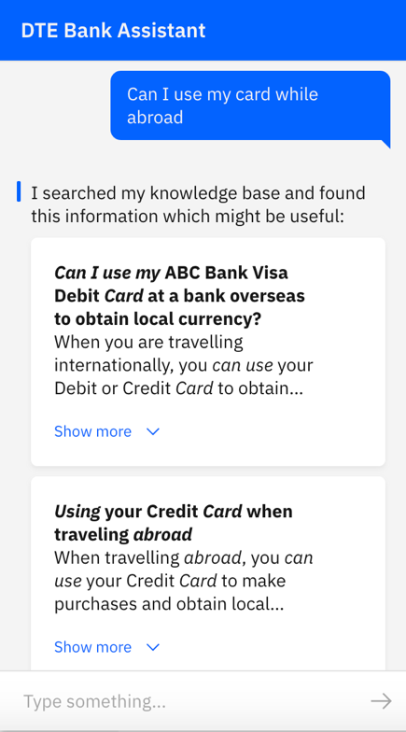
접근 가능하고 확장 가능한 AI Watson Discovery와의 사전 구축된 통합
Sa
조직 내의 기존 콘텐츠를 사용하여 어시스턴트의 적용 범위를 향상시킵니다.
AI가 복잡한 문서에서 관련 답변을 찾고 강조 표시하도록 합니다.
마케팅 페이지 및 knowledge base 문서와 같은 기존 콘텐츠에서 답변을 찾아냅니다.
미리 구축된 커넥터를 사용하여 기존 데이터 소스를 인덱싱 및 검색합니다
Learn → | Blog → | Demo →
Notes:
Much of an organization’s institutional knowledge is buried in unstructured documents. With the addition of Watson Discovery, organizations can catalog unstructured information from their document repositories and enable people to ask natural language questions against them. The watsonx Assistant search skill is the mechanism used to integrate a virtual assistant to the Watson Discovery service that has cataloged the organization’s documents.
IBM watsonx Assistant integration with Watson Discovery means agents no longer need to manually read documents and use Find (Control-F) to look for specific bits of information. IBM watsonx Assistant search skill enables customers themselves to ask questions against large corpuses of data from within a virtual assistant.
In addition, when paired with watsonx.ai and large language models (LLMs), the Assistant generates succinct, to the point, and natural sounding answers.
Citations:
https://medium.com/ibm-watson/answering-more-questions-with-minimal-effort-46eb0b5c2b49
https://www.ibm.com/products/watson-assistant/demos/lendyr/demo.html?section=accessible-scalable-ai&panel=accessible-search
https://ibm.box.com/v/wa-integrations-deepdive (IBMers only)

Slide 23
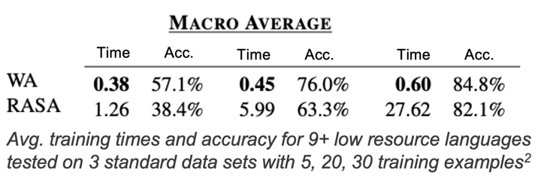
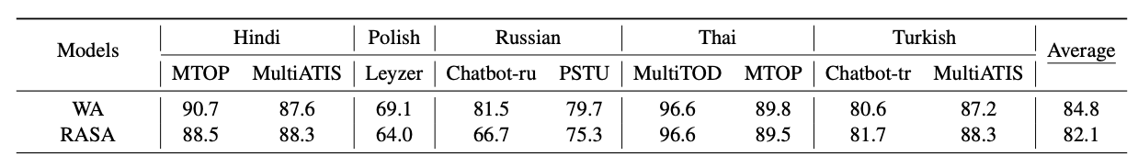
Accessible and scalable AI 범용 언어 모델
IBM의 고유한 범용 언어 모델을 통해 고객은 리소스가 한정적인 언어를 엔드 유저에게 지원할 수 있습니다.
최소한의 학습 예제만을 필요로 하면서 모든 언어로 더 정확하게 학습할 수 있습니다.
Blog →
Notes:
IBM’s unique universal language model allows clients to support their customers across any language, with higher accuracy, and a minimal amount of training.
This self-explanatory slide includes comparative benchmark test results against another popular vendor, which shows that IBM watsonx Assistant can be trained in a small fraction of the time, while still outperforming in terms of accuracy.
Learn more here: https://medium.com/ibm-watson/an-assistant-for-any-language-69e12a75024f

Slide 24


여러 언어에서 어시스턴트 구축 및 관리
클라이언트는 비동기 번역과 런타임(실시간) 번역 중에서 선택할 수 있으며 수동, LLM 기반 또는 기계 번역 중 use case에 가장 적합한 방법을 선택할 수 잇습니다.
비동기
watsonx Assistant
가상 어시스턴트 #1
Primary language
가상 어시스턴트 #2
Secondary language
클라이언트는 각 언어에서 콘텐츠와 흐름을 세부적으로 제어할 수 있으며 어시스턴트 언어를 정확하게 구사하도록 할 수 있습니다. 초기 번역은 기계 번역 또는 watsonx LLM 기반일 수 있으며, 그런 다음 수동 번역가가 큐레이팅할 수 있습니다.
런타임(실시간)
watsonx Assistant
가상 어시스턴트 #1
Primary language
고객은 실시간 기계 번역 또는 LLM 기반 번역에 의존하여 최소한의 노력으로 구축 및 관리하여 다양한 언어로 여러 어시스턴트를 제공할 수 있습니다.
번역 서비스 파트너
써드 파티 번역 서비스
Notes:
Setting up a multilingual virtual assistant involves either one-time or runtime translation.
An assistant is usually built in the primary language used by users. For users that do not speak that language, clients can translate what the assistant says to their language and translate what they say back to the assistant language at every utterance. This is runtime or real-time translation. This allows clients to only maintain one virtual assistant and still interact with end users in any language, which means less building and management. For the translation service, clients can use watsonx LLMs, a partner translation service such as NeuralSeek, or a third-party translation service of a client’s choosing.
Another approach is to translate the primary language assistant and add a secondary language assistant. In this scenario, clients make updates to the primary assistant and then push changes to the secondary language assistant with either manual or machine translation. The reason clients choose this option is because it provides granular control over every single word that the secondary language virtual assistant generates. With runtime translation, the client is relying on a real time machine translation, which may not work optimally in all use cases. Adding secondary language assistants doesn't mean the whole process is is manual. Typically, clients first rely on machine or watsonx LLM-powered translation, and then curate it with experts in both languages.
Thus, watsonx Assistant gives clients the flexibility to choose whichever approach for translation works best for their use case. It supports manual, LLM-powered and machine-powered translation, whether asynchronous or at runtime.

Slide 25



일관되고 개인화된 경험 CCaaS 플랫폼과의 사전 구축된 통합
Sa
Watson
Assistant
현재 NICE CXone, Genesys 및 Twilio Flex를 사용 가능합니다
Public Internet
SIP Trunk
Public Switched Telephone Network (PSTN)
Amazon Chime Voice Connector
Amazon Connect
Update Contact Attributes API
Learn → | Blog → | Demo →
Notes:
An increasing number of clients are moving their contact center software to the cloud. This type of software is called contact center as a service (CCaaS).
IBM watsonx Assistant offers built-in integration with several vendors, as shown on this slide, with additional vendor integration support planned.
Citations:
https://www.ibm.com/blogs/journey-to-ai/2022/08/press-one-for-call-center-modernization/
https://www.ibm.com/products/watson-assistant/demos/lendyr/demo.html?section=index&panel=live-agent
https://ibm.box.com/v/wa-voice-deepdive (IBMers only)

Slide 26
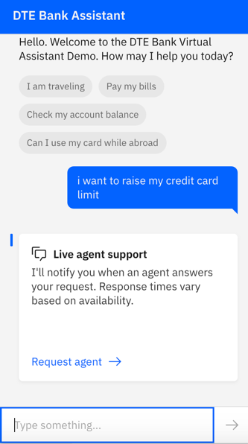
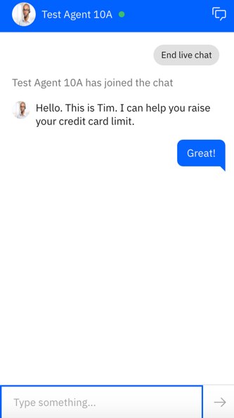

일관되고 개인화된 경험 상담원 인계 및 라우팅
Sa
필요에 따라 적합한 사람 상담원에게 라우팅합니다.
고객이 상담원의 응답을 기다리는 동안 셀프 서비스를 계속합니다.
주요 고객 서비스 플랫폼에 사용할 수 있는 커넥터가 있습니다.
Learn → | Blog → | Demo →
Notes:
Key hallmarks of high-quality customer experiences are consistency and continuity. Given the range of issues customers need to express in the various omni-channel conversation interfaces, there will be many situations where a hybrid approach of both a virtual agent and a human agent will be needed. For sensitive and complex questions or requests, both organizations and customers alike may prefer a human agent.
The key point here is that the customer shouldn’t need to manually leave one channel to join another, and that the entire context and chat history is visible to both parties after a switch has been made from a virtual agent to a live agent.
IBM watsonx Assistant has built-in integrations to hand conversations off to live agents in any of a number of messaging environments: Salesforce, Zendesk, Intercom, Facebook Messenger, Slack, telephony systems, and other custom applications. This is a no-code integration – no developers are needed.
Even after the hand-off is initiated, IBM watsonx Assistant stays with the customer, and continues to answer their questions while they wait for an agent’s response.
Citations:
https://www.ibm.com/blogs/watson/2021/11/getting-started-with-the-new-watson-assistant-plan-it/
https://www.ibm.com/products/watson-assistant/demos/lendyr/demo.html?section=index&panel=live-agent
https://ibm.box.com/v/wa-agentescalation-deepdive (IBMers only)

Slide 27
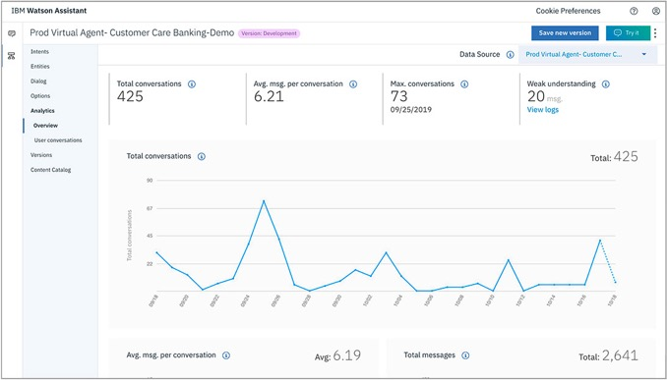
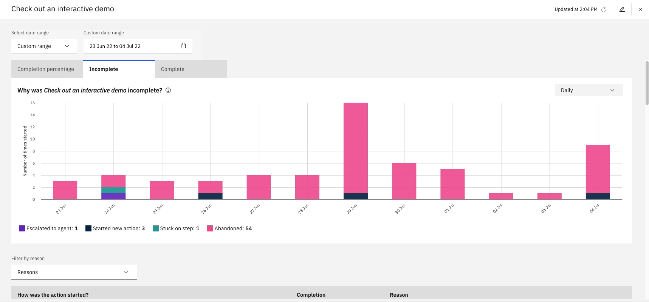
진정한 고객 성과 분석
고객의 지원 여정에 대한 엔드 투 엔드 뷰
메시지 데이터의 추세 시각화
문제 해결을 위한 조치를 취하고, 대화 흐름들을 반복해보고, 성능을 향상시킵니다.
IBM watsonx Assistant는 고객 상호작용을 통해 학습하고 향상된 경험을 제공할 수 있습니다.
Learn → | Blog → | →
Notes:
As virtual assistants are pushed into production, IBM watsonx Assistant tracks many metrics relating to their performance. There are higher-level counting statistics, like total conversations, and the number of messages. There are also business value-oriented metrics, like containment (deflection) rate, which represents the percentage of conversations where the virtual assistant satisfied the customer’s requests without a human agent’s help. IBM watsonx Assistant includes easy-to-use analytics dashboards in its tooling, which allows clients to visualize trends in the user message data and take action to fix problems, iterate on improving conversation flows, and improve performance.
As an AI-oriented solution, IBM watsonx Assistant uses machine learning (ML) techniques to make its virtual assistants even smarter - clients can turn on a feature for their virtual assistants to enable autolearning. IBM watsonx Assistant then examines the metrics data as it looks for patterns in customer interactions, and then creates an improved experience based on what it has learned.
For example, let’s say a client has a virtual assistant that provides weather information. It’s common practice for people to ask an ambiguous question like this: “What’s the weather now in downtown Toronto?” The client’s service offers multiple metrics for weather, so in the dialog flow, they use disambiguation to clarify what specific weather metric the user is interested in, by presenting an ordered list of options. If users tend to choose “temperature and precipitation” most of the time, watsonx Assistant can learn from this interaction and present this option at the top of the list to simplify the user experience.
The bottom screenshot on the right demonstrates another capability (click “Play” by clicking on the graphic) – how IBM watsonx Assistant makes it easy for authors to identify, review and fix an existing flow—in the same day they identified the problem! This dashboard shows that customers are usually not completing this particular action – the purple color means they are abandoning it. The detail notes behind this short demo can be found in the IBM watsonx Assistant presentation: https://ibm.seismic.com/Link/Content/DC37bmD933CgW8WH6GgmVC3Wb2F3.
Citations:
https://www.ibm.com/blogs/watson/2022/01/getting-started-with-the-new-watson-assistant-part-iii-test-and-deploy/
https://ibm.box.com/s/59kjj2ehtdich9drffo6fmtqzr7yemh9 (IBMers only)
https://ibm.box.com/v/wa-analytics-deepdive (IBMers only)

Slide 28
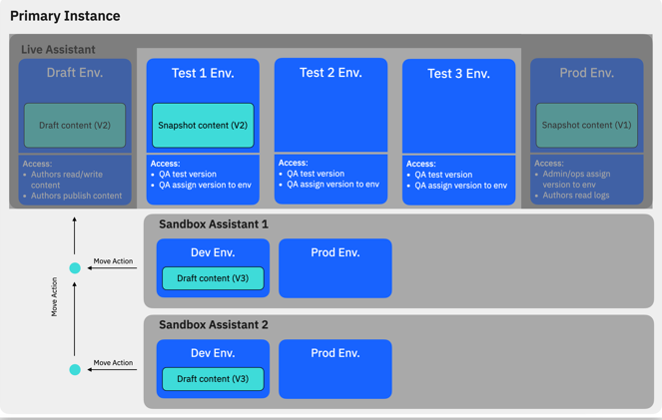
기업을 위한 설계 접근 및 라이프사이클 관리
라이프사이클을 관리합니다.
가상 어시스턴트의 개발 및 유지보수를 관리하기 위해 사용자 역할을 지정할 수.있습니다.
대화 기술 버전 관리로 라이플사이클 관리 기능을 완성시킵니다.
Notes:
Access control provides collaborators with roles that set different levels of permissions to view and configure IBM watsonx Assistant skills. This feature, coupled with the ability to apply versioning, ensures a complete lifecycle management capability.
Citations:
https://ibm.box.com/v/wa-lifecycle-deepdive (IBMers only)
https://ibm.box.com/v/wa-enterpriseadmin-deepdive (IBMers only)

Slide 29

기업을 위한 설계 유연한 배포
Sa
watsonx Assistant SaaS 서비스를 사용하여 IBM Cloud에 배포하세요
IBM watsonx Assistant를 프라이빗 클라우드, 기타 벤더사의 클라우드 또는 온프레미스에서도 배포할 수 있습니다.
Learn →
Notes:
The easiest and fastest way to get started with IBM watsonx Assistant is with the Software-as-a-Service (SaaS) service on IBM Cloud. There are a range of service plans, including a free tier, and a premium trial, so clients can get started at no cost. (Pricing is covered later in this presentation.)
Clients can also deploy IBM watsonx Assistant with Cloud Pak for Data on any cloud – IBM, Amazon, Google, Microsoft. In addition, for complete control and isolation, clients can also deploy IBM watsonx Assistant in a private cloud or in their own datacenter using the IBM watsonx Assistant cartridge which makes the software available on-premise. For situations where clients need to ensure high concurrency rates (meaning, many people can have active chat sessions at the same time), or high security, an on-premises deployment is desirable.
Learn more: https://ibm.box.com/v/wa-deployment-deepdive (IBMers only)

